Slide 1
What is the Census?
Every 10 years, the U.S. government counts every person living in the U.S., through the Census.
The Census is a short questionnaire that asks basic information about your household and the people who live in it.
https://my2020census.gov/

Slide 2
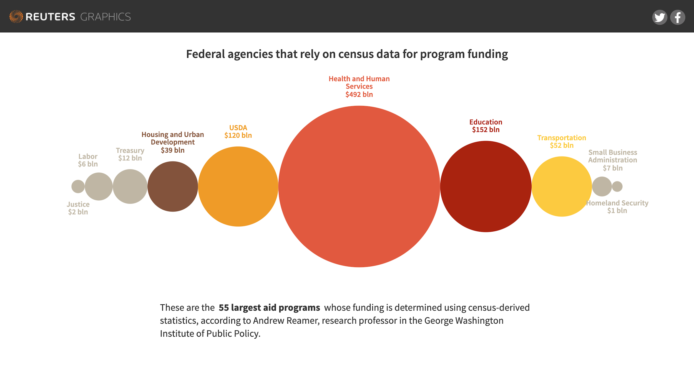
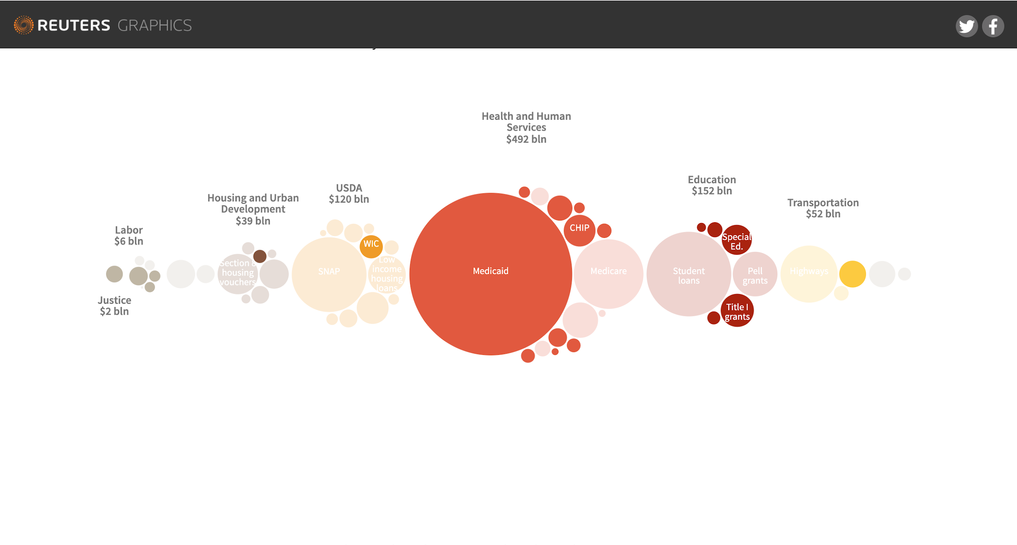
https://my2020census.gov/
Notes:
https://graphics.reuters.com/USA-CENSUS/010092JZ39N/index.html

Slide 3
What does the Census ask?
When is the next Census?
April 2020!
If you live off campus, expect to get some mail from the Census Bureau in March with details on how to self-respond to the Census. Only one form should be completed for each household.
It asks 9 questions of every household.
https://my2020census.gov/

Slide 4
Responding to the Census is quick and simple! How?
Answers are confidential –
By law (title 13 of the US Code), the Census data CANNOT be shared with other government agencies.
The Census will NOT ask about citizenship or immigration status.
You can respond online
The Census Bureau will send you instructions in mid-March 2020. Go to the official Census website, enter your household ID, and then answer the questions.
You can respond by phone
Call the Census Bureau to answer the census by phone and ask questions about the Census.
Available in 12 languages.
If you do not respond to the Census online or by phone, the Census Bureau will mail you a paper questionnaire.
If you do not respond, by May 2020, a census employee may come to your home to ask for the information in person.
https://my2020census.gov/
Notes:
Self-respond online or over the phone available until June 2020

Slide 5
What about students who have moved due to COVID19?
Students should be counted where they live most of the time (e.g., residence halls, even if currently displaced).
Since they may not receive invitation letters, they should use the non-ID response option (i.e. press 'if you do not have a Census ID, click here')
College students continuing to live on-campus will be counted by their college/university as was originally planned.
https://my2020census.gov/

