Slide 1
Gender, Race, and Rock n’ Roll:
Independent Musical Subcultures in a Neoliberal Context
Tracy Gardner
tlgardne@uci.edu

Slide 2


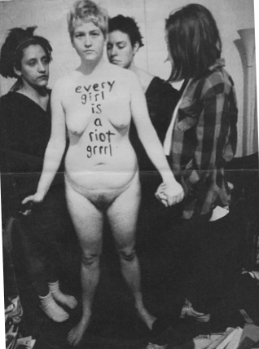

Driving Questions:
How did we go from this:

Slide 3



To this?

Slide 4
Audio subcultures transcend their sound properties to encompass aesthetics and technologies that indicate an underlying ideology. In this paper I argue that audio subcultures do not provide opposition to hegemonic norms because they rely on the very production of capital and discourse that they claim to resist. Riot Grrrl was unsuccessful and so quickly re appropriated into the hegemonic main stream because of the structural methods of production from which it relied.

