Slide 1
The Culture of Abuse How DADT contributes to sexual violence against women in the military today
Esther Choi

Slide 2
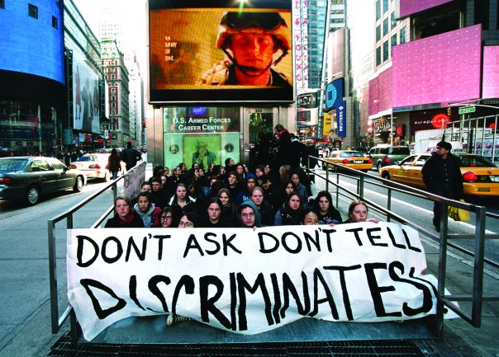
Thesis

Slide 3
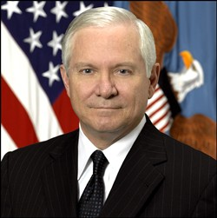
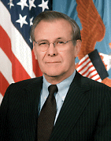
Case Study
Federal lawsuit filed February 15, 2011 against Department of Defense by veterans and active-duty service members.
DOD Secretary
Robert M. Gates
Predecessor
Donald Rumsfeld

Slide 4
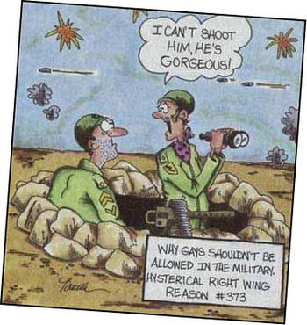
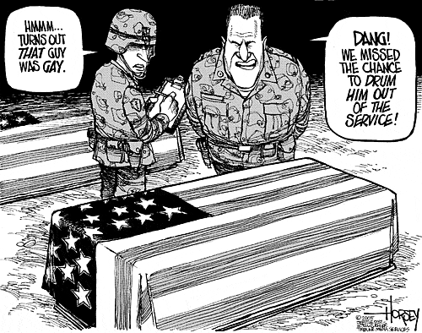
“Don’t Ask, Don’t Tell” Policy
Homophobic
“I can’t shoot him, he’s gorgeous!”
“Why gays shouldn’t be in the military. Hysterical right wing reason #373”
“Hmmm … turns out that guy was gay.”
“Dang! We missed the chance to drum him out of the service!”

Slide 5
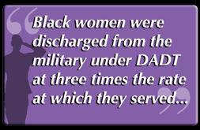
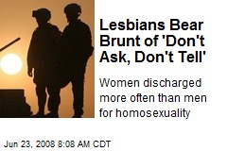
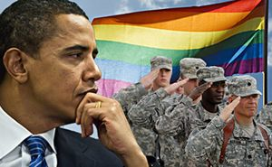
Other scholars argue:
Racist
Sexist

Slide 6
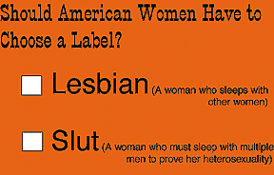
My Argument
Connecting the federal lawsuit and DADT policy
How homophobic stigma hurts all women in the military through lesbian baiting

