Slide 1
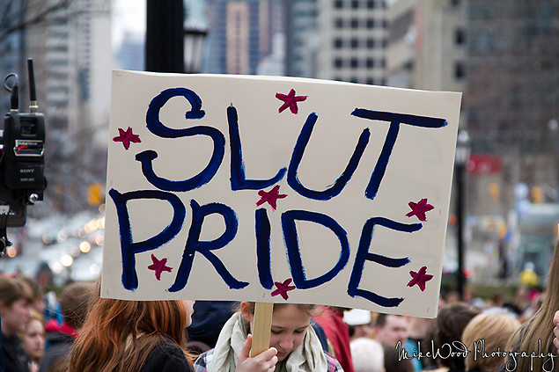
“Slut!”:
The Shaming and Reclaiming of Feminine Sexual Desire in the Contemporary U.S.
Kristin Bollingmo

Slide 2
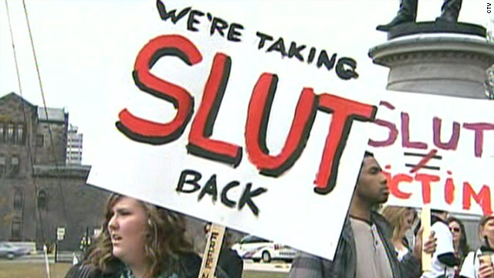
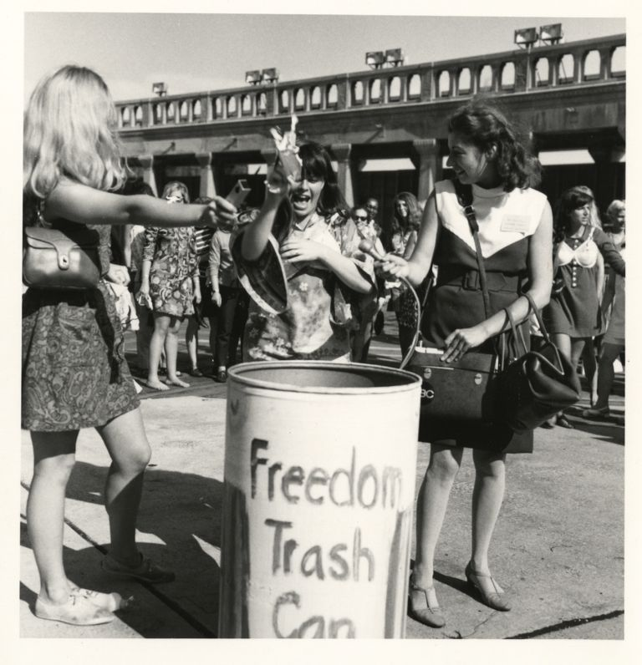
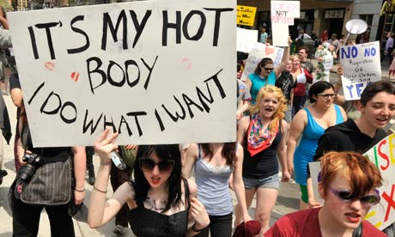
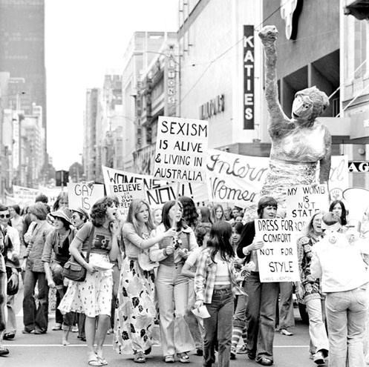
Research Focus
Politics of “slut”
“Slut-Shaming” as a neologism
Slutwalk and feminist tensions
“Rock the slut vote” and the complexities of online medias

Slide 4
Nationalism
Going Viral

Slide 5
Why Now?
The current political debates involving health care coverage of contraception combined with virility of internet trends has allowed increased public attention to the neologism “slut-shaming” and the term “slut” as well as their implications on feminine sexual desire.

